Slide 1
Group 7
By: Deependra Basnet, Manale Henini, and Orion Lowy

Slide 2
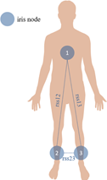
Introduction
We chose to use the Activity Recognition system based on Multisensor data fusion (AReM) Data Set.
Temporal data from a Wireless Sensor Network worn by an actor performing the following activities: bending, cycling, lying down, sitting, standing, walking
7 attributes: time step measurement, and mean and variance values for the RSS data of each of the 3 nodes
Goal: Predict which activity is being performed based on the values of the attributes

Slide 3
SVM- Support Vector Machine
Classification and regression analysis of a data based on the number of classes
We separate the classes using hyper plane also known as decision boundary
Choose the right hyper plane

Slide 4
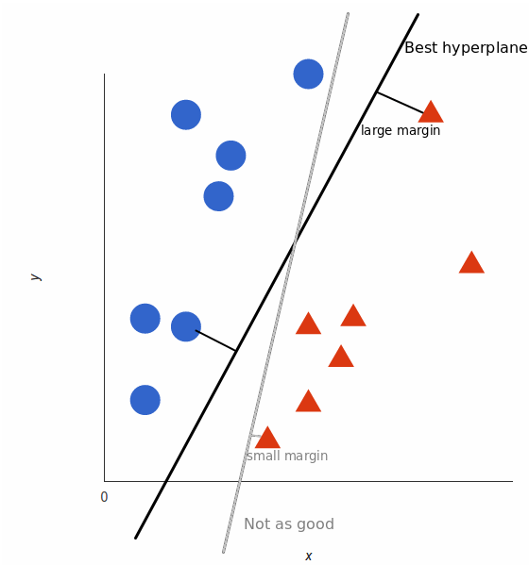
Linear Data
This is a classified graph for linear data
The plane with the highest margin from both
classes will be the best fit

Slide 5
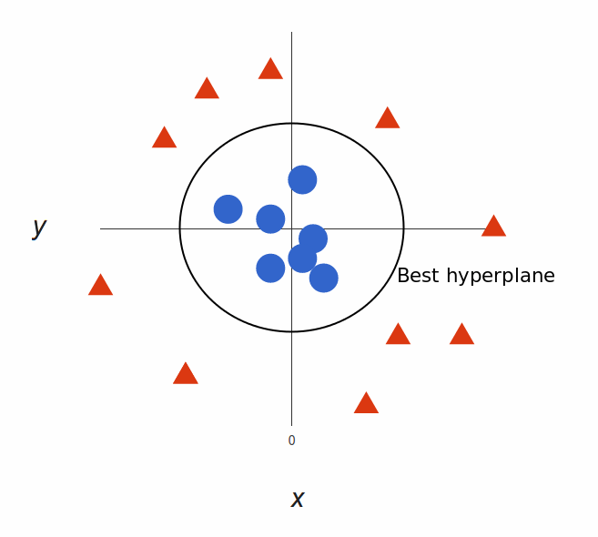
NON-LINEAR DATA
Classified Non-linear data
New dimension to separate the datas

Slide 6
Accuracies on different kernels
RADIAL - 73.82%
POLYNOMIAL - 72.24%
LINEAR - 67.04%
SIGMOID - 52.77%

Slide 7
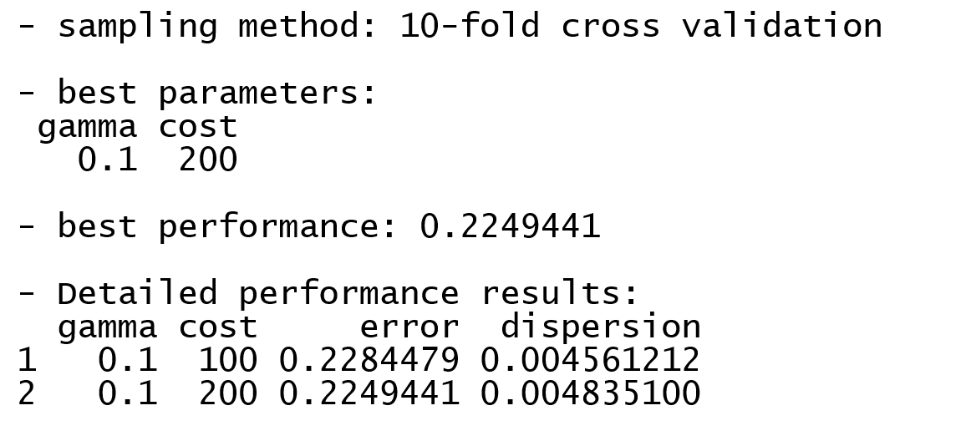
Tuned Model and Best Model
10 fold cross validation method to find the best accuracy

Slide 8
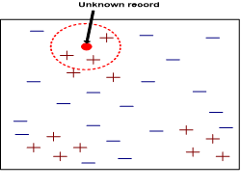
KNN
Basic Algorithm: Given a data point, use a distance formula to find the K nearest neighbors. Assign the data point the same class as the majority class from the neighbors.
Preprocessing:
Missing Data: The data set did not have any missing data
Scaling: The attributes didn’t have the same range, so they were normalized to prevent one attribute from dominating others.

Slide 9
KNN Cont.
Preprocessing Cont.:
Randomizing: The data set was originally grouped by class. To prevent classes from being over/underrepresented in the subsets, we shuffled the data.
Choosing k: If it’s too small, the model will be too sensitive. If k is too big, data points from other classes will be included.
General rule of thumb: k should initially be the square root of the size of the training set. The training set was ~38015 rows, so k started around 195.

Slide 10
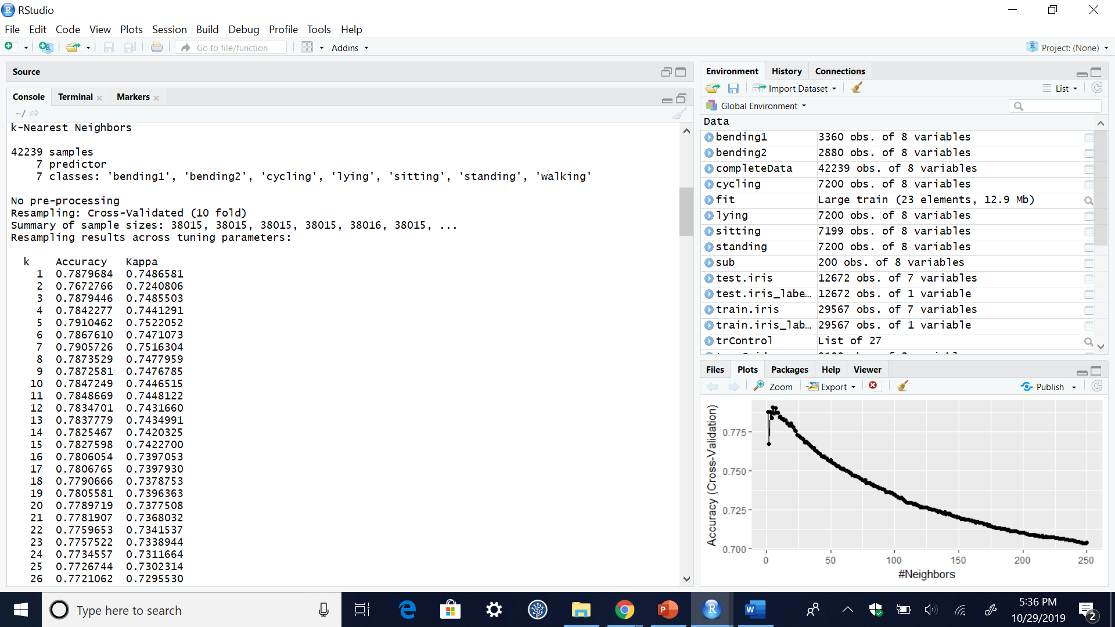
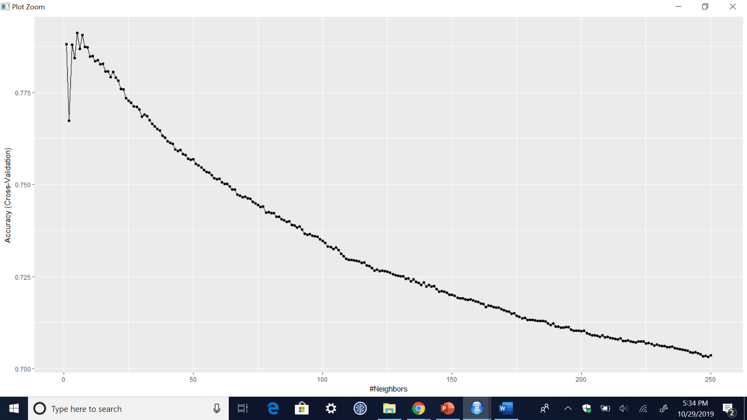
KNN Cont.
10 Fold Cross Validation Results:

Slide 11
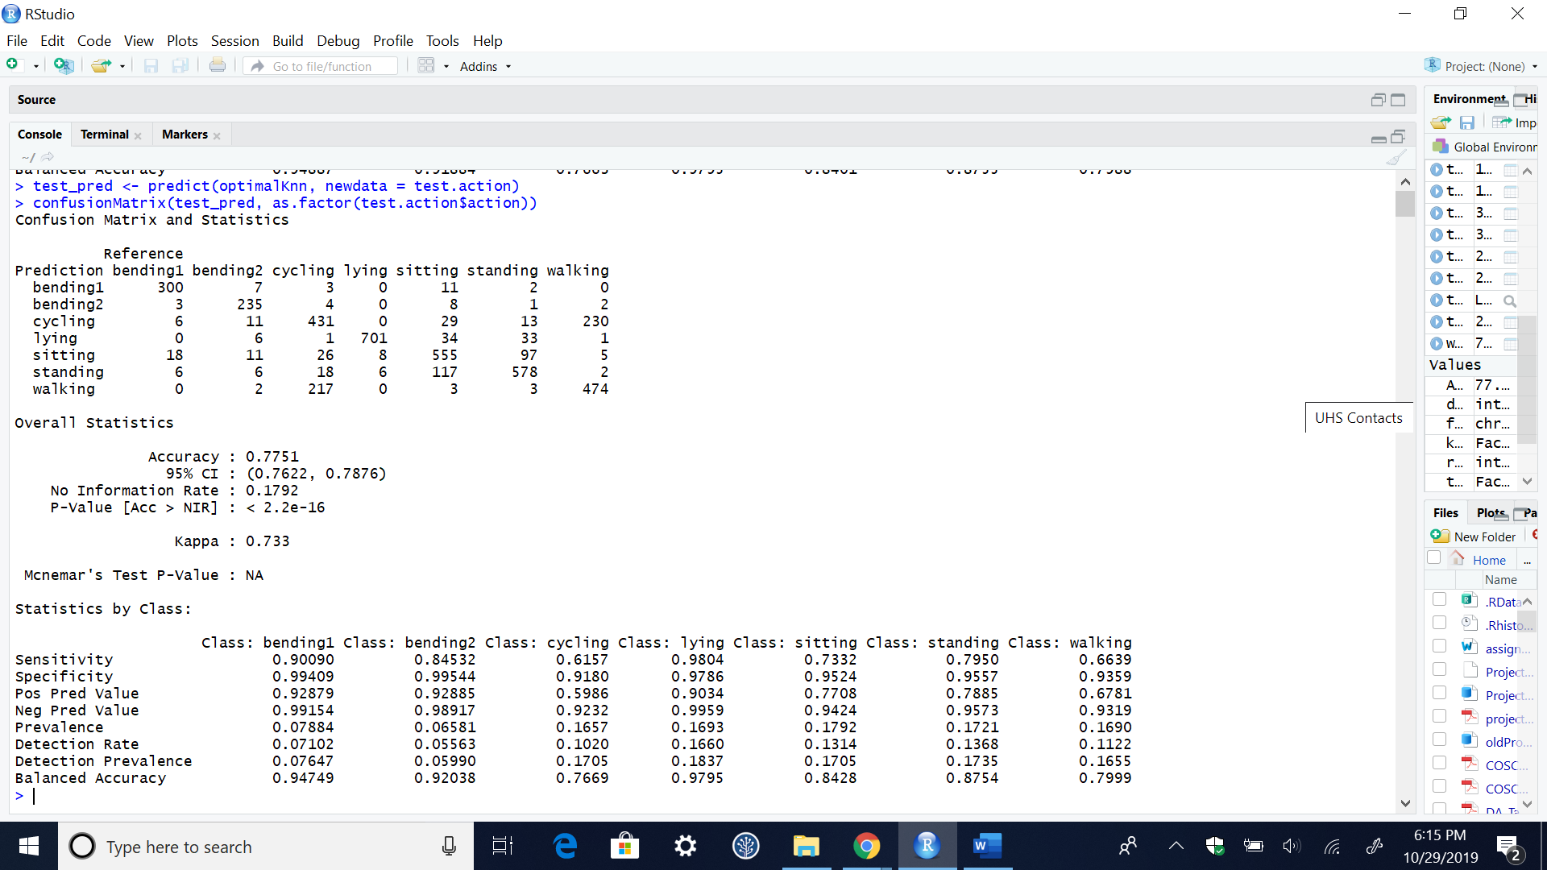
KNN Cont.
Potential Improvements:
Explore different options for k
Try a different distance function (the default distance function is Euclidean)

Slide 12
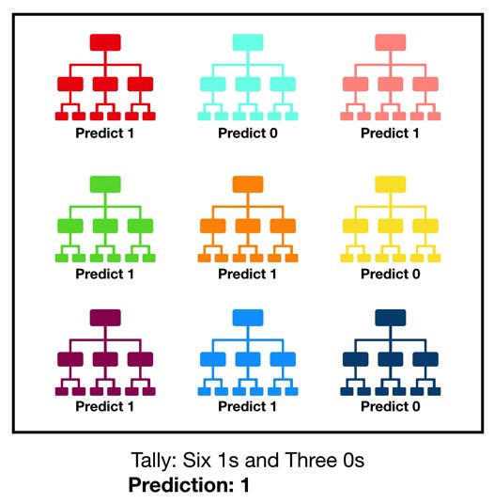
Random Forest
An ensemble of Decision Trees
Each tree created using random choices of parameters, used to generate one sub-decision or “vote”
Majority vote of all trees: decision of whole forest
Accuracy + than single decision tree because it filters out individual mistakes
https://towardsdatascience.com/understanding-random-forest-58381e0602d2

Slide 13
Random Forest
Preprocessing: Since the Random forest technique already uses random sampling, we did not shuffle the data beforehand.
Choice of Parameters: ntree (# trees in forest) = 500, mtry (# of variables selected per tree) = 4
ntree = 500 was a reasonable default value.
mtry = 4 was the value that had optimal accuracy as found during the cross-validation process.

Slide 14
Random Forest
Confusion Matrix
 | bending1 | bending2 | cycling | lying | sitting | standing | walking | class.error
bending1 | 3134 | 13 | 29 | 1 | 141 | 41 | 1 | 0.067261905
bending2 | 59 | 2585 | 89 | 19 | 69 | 16 | 43 | 0.102430556
cycling | 10 | 38 | 5127 | 2 | 135 | 71 | 1817 | 0.287916667
lying | 0 | 5 | 7 | 7140 | 15 | 26 | 7 | 0.008333333
sitting | 81 | 88 | 182 | 50 | 5930 | 823 | 45 | 0.176274483
standing | 18 | 7 | 136 | 90 | 694 | 6219 | 36 | 0.13625
walking | 0 | 49 | 1629 | 2 | 23 | 23 | 5474 | 0.239722222
Accuracy: 84.1%
Kappa: 81.2%

Slide 15
Conclusion
The models had issues with classifying cycling and walking because they are very similar actions.
Random forest gave the highest accuracy, so it would be the best classification model for this dataset.

